Slide 1
Phonics Screening
Information Evening

Slide 2
What is phonics screening?
The phonics screening check is a compulsory assessment taken individually by all children in Year 1 in England. It is designed to give teachers and yourselves information on how your child is progressing in phonics. It will help to identify whether your child needs additional support at this stage so that they do not fall behind in this vital early reading skill.
The check consist of 40 words that your child will be asked to read one to one with a teacher. It will consist of some real words and some nonsense/ pseudo words. They are all phonetically plausible and will take 5-10 minutes to complete.

Slide 3
What does it check?
It checks that your child can:
Sound out and blend graphemes in order to read simple words.
Read phonically decodable one-syllable and two-syllable words, e.g. cat, sand, windmill.
Read a selection of nonsense words which are referred to as pseudo words.

Slide 4
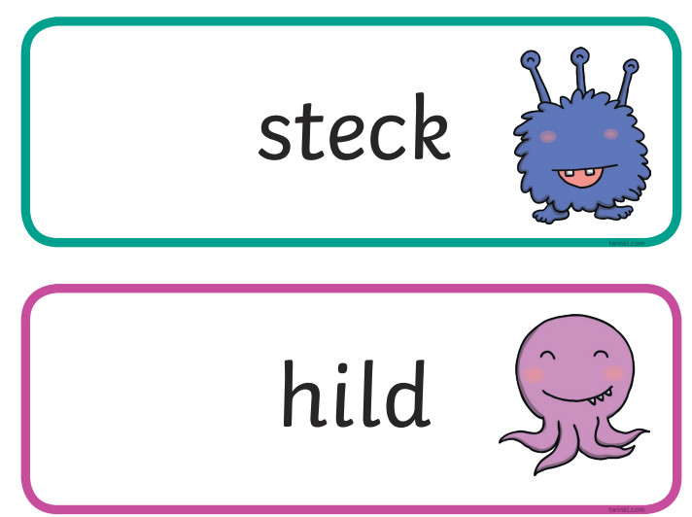
What are pseudo/nonsense
words and why are they included?
These are words that are phonically decodable but are not actual words with an associated meaning e.g. brip, snorb.
Pseudo words are included in the check specifically to assess whether your child can decode a word using phonics skills and not their memory.
The pseudo words will be shown
to your child with a picture of a
monster.

Slide 5
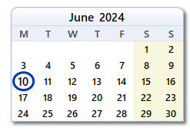
When does the check take place?
These will be taking place in the week commencing 10th June 2024.

Slide 6
What is the pass mark?
The last few years, the pass mark has been 32/40 and is unlikely to change.
However, we will not be told the threshold for this year until 24th June.

Slide 7
What happens if my child does not
reach the pass mark?
If a pupil does not meet the expected standard at the end of year 1, a programme of support will be put in place and they will re-take in year 2.

Slide 8
What happens to the results?
The results are not publicly published or used in any performance data (league tables).
They are reported to the Local Authority and to you.

Slide 9
What can you do to help at home?
Read! Read! Read as much as possible!
Please talk to your child about this upcoming check prior to the week commencing the 10th June and you could do some practising at home.

Slide 10
What can you do to help at home?
Here are some helpful websites:
Alphablocks - lots of videos and games to help with recognising letters and reading. www.bbc.co.uk/cbeebies/shows/alphablocks
​Phonics Games - A variety of different interactive games
www.ictgames.com/mobilePage/forestPhonics/index.html
​
BBC Bitesize - this game allows your child to listen to the sounds in a word and to pick the correct letter. Then they can see what word they have made with all of the sounds together. www.bbc.co.uk/bitesize/topics/zyfkng8/articles/zt27y4j
Phonics play - there are several free games to play that will help your child with their blending and segmenting.
www.phonicsplay.co.uk/Phase3Menu.htm

Slide 11
Past paper examples to use at
home
You can find all the past papers from previous years on the gov website. Some of these have been used in school and they can also be used as a practise at home.
Simply search:
Gov.uk phonics screening 2017
Gov.uk phonics screening 2018
Gov.uk phonics screening 2019
Gov.uk phonics screening 2020
Gov.uk phonics screening 2021
Gov.uk phonics screening 2022
Gov.uk phonics screening 2023

Slide 12
Any questions?

