Slide 1

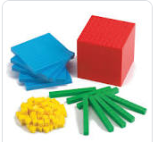

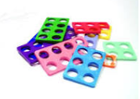
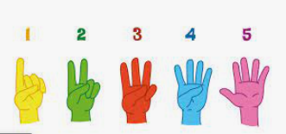
Maths @Newton Primary School
5.12.2023
Please touch the equipment!

Slide 2

The purpose of the meeting is:
To get an insight into how Maths is taught at Newton Primary School.
To gain an understanding of the National Maths curriculum and expectations.
To take away some ideas to support your children at home.

Slide 3
Numberless
If all the numbers in the world were rubbed out, removed, taken away:
I wouldn’t know how old I was,
I wouldn’t know the time of day,
I wouldn’t know which bus to catch,
I wouldn’t know the number of goals I had scored,
I wouldn’t know how many scoops of ice-cream I had,
I wouldn’t know the page on my reading book,
I wouldn’t know how tall I was,
I wouldn’t know how much I weighed,
I wouldn’t know how many sides there are in a hexagon,
I wouldn’t know how many days are in the month,
I wouldn’t be able to work my calculator.
And I wouldn’t be able to play hide-and-seek!
But I would know as far as my mum was concerned I was still her NUMBER ONE!
Ian Souter

Slide 4

Maths @ Newton

Slide 5




Attitudes towards maths
The best thing that parents and carers can do for children is to have a positive attitude towards maths. Please don't say things like "I can’t do maths" or "I hated maths at school"; your child might start to think like that themselves.
Point out the maths in everyday life. Include your child in activities involving maths such as using money, cooking and travelling.
Praise your child for effort rather than talent - this shows them that by working hard they can always improve.

Slide 6
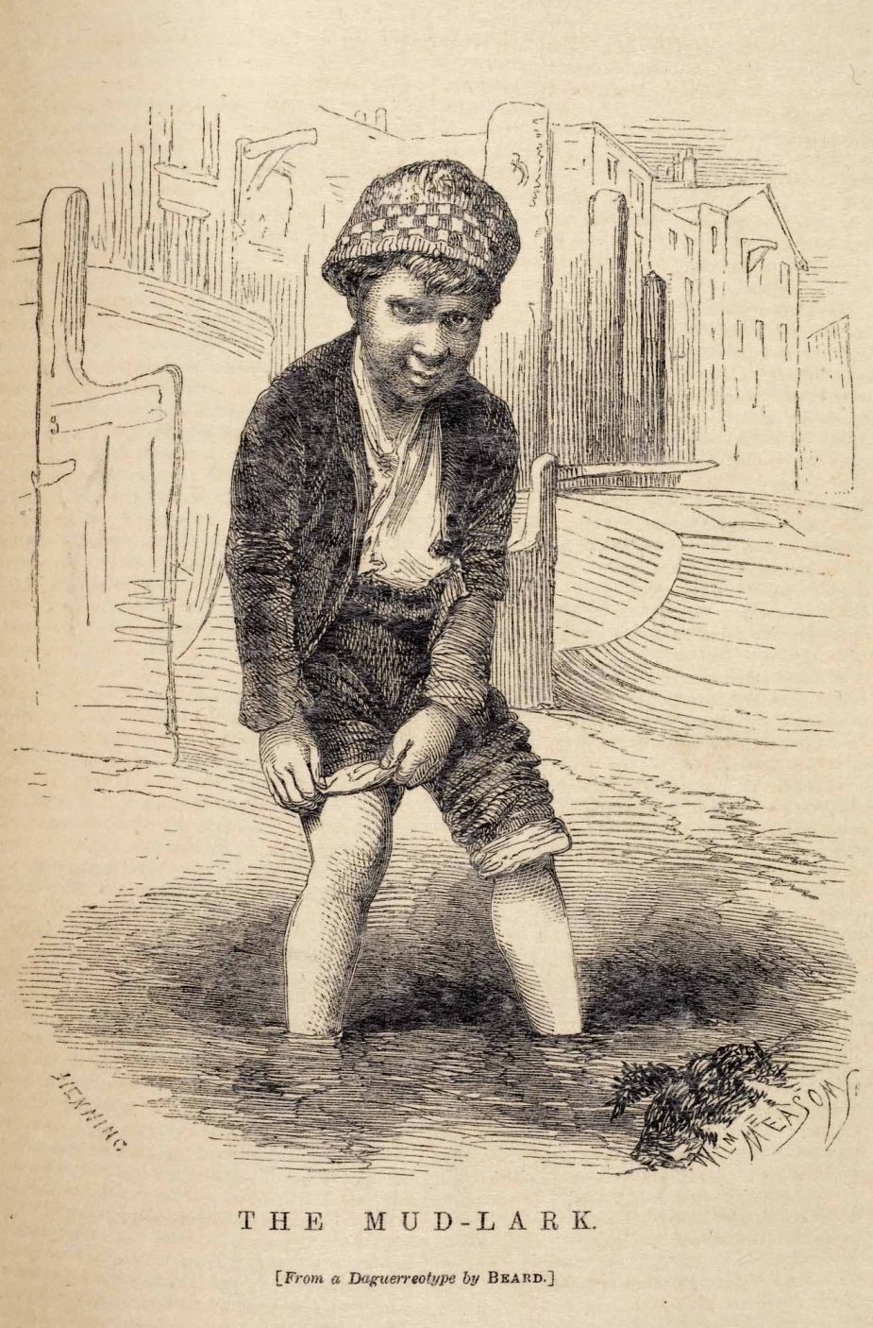
They didn’t do it like that in my day!

Slide 7
Current teaching methods
Some areas of the maths curriculum are taught differently today to how most adults were taught at school.
We know that lots of parents and carers find it helpful to understand how their children are taught, so we are here to explore some of the resources and to explain teaching methods clearly.

Slide 8
Overview The national curriculum began in 1989 and was most recently revised in 2014. It is a set of subjects and standards used by schools so that all children learn the same core topics. It explains which subjects are taught and the standards children should reach in each subject. Key Stages The national curriculum is organised into blocks of years called ‘key stages’ (KS). At the end of each key stage, your child will be formally assessed, although this year KS1 assessments do not need to be reported nationally.

Slide 9
National Curriculum Aims
Aims for all pupils to:
• become fluent in the fundamentals of mathematics, including through varied and frequent practice with increasingly complex problems over time, so that pupils develop conceptual understanding and the ability to recall and apply knowledge rapidly and accurately
• reason mathematically by following a line of enquiry, conjecturing relationships and generalisations, and developing an argument, justification or proof using mathematical language
• can solve problems by applying their mathematics to a variety of routine and non-routine problems with increasing sophistication, including breaking down problems into a series of simpler steps and persevering in seeking solutions

Slide 10
KS1 Statutory Curriculum covers
– Number and place value
– Addition and subtraction
– Multiplication and Division
– Fractions
– Measurement
– Geometry – properties of shape / position and direction
– Statistics (Year 2) – The curriculum is designed so that pupils explore mathematical ideas in depth.

Slide 11
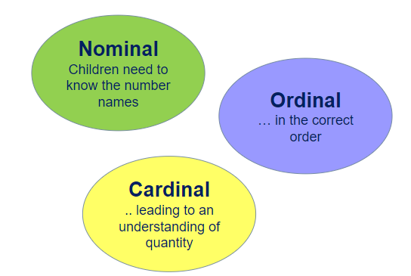
Numbers, like letters are abstract symbols that we need to learn…

Slide 12
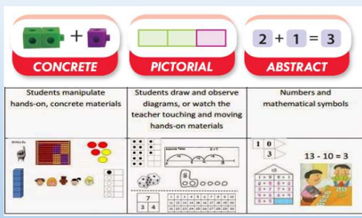
How we teach maths
Concrete representation
This is a 'hands on' component using real objects and it is the foundation for conceptual understanding
Pictorial representation
Using representations, such as a diagram or picture of the problem
Abstract Experiences
The symbolic stage - a student is now capable of representing problems by using mathematical notation, for example: 12 ÷ 2 = 6

Slide 13
By end of Reception…
The aim is for children to be able to:
• Count reliably with numbers from one to 20, place them in order and say which number is one more or one less than a given number.
• Using quantities and objects, they add and subtract two single-digit numbers and count on or back to find the answer.
• They solve problems, including doubling, halving and sharing.

Slide 14
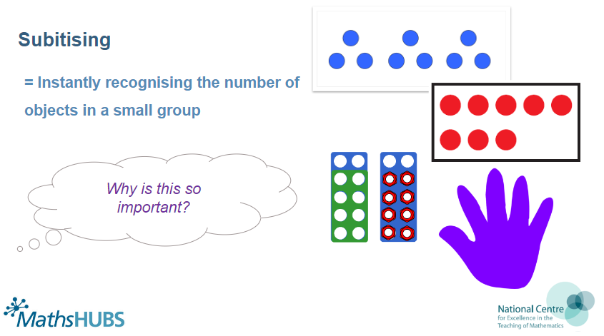
Subitising

Slide 15

Count the dots…

Slide 16

Reception
Equality–‘seven is the same total as four add three’ e.g.
Subitising–‘instantly recognizing the number of objects in a small group, without counting them’ e.g. =5
Conservation of number –‘recognising that a value of objects are the same, even if they are laid out differently’ e.g.

Slide 17



Reception cont.
One-to-one correspondence e.g.
• Counting on and back from any number – e.g. ‘five add three more totals eight’ ‘ten take away three totals seven’
Using apparatus and objects to represent and communicate thinking
Maths language – using mathematical words verbally in every-day situations – e.g. ‘climb up to the top’ / ‘climb down to the bottom’

Slide 18
Year 1
Count to and across 100, forwards and backwards from any number.
Read and write numbers to 20 in numerals and words.
Read and write number to 100 in numerals.
Say 1 more/1 less to 100.
Count in multiples of 2, 5 and 10.
Use bonds and subtraction facts to 20.
Add and subtract 1 digit and 2 digit numbers to 20, including zero.
Solve one-step multiplication and division using objects, pictorial representation and arrays.
Recognise half and a quarter of object, shape or quantity.
Sequence events in chronological order.
Use language of day, week, month and year.
Tell time to hour and half past.

Slide 19
Number bonds
a number bond is a simple addition sum which has become so familiar that a child can recognise it and complete it almost instantly, with recall as automatic as that of an entry from a multiplication table in multiplication

Slide 20
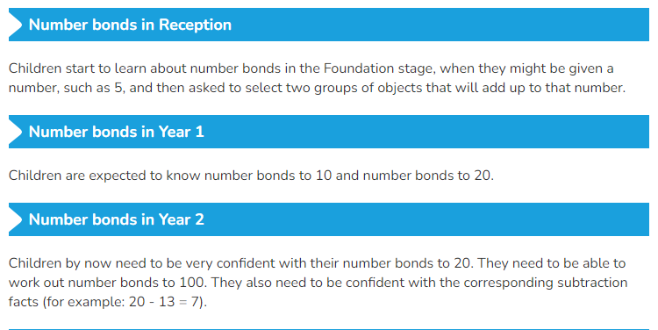
Why are Number bonds so important?
Notes:
They show how numbers join together, and how they break down into component parts. When used in Year 1, number bonds forge the number sense needed for early primary students to move to addition and subtraction. As students progress, number bonds become an essential mental problem-solving strategy. They will be able to see that numbers can be split into component parts, which will help them with adding or subtracting larger numbers.

Slide 21
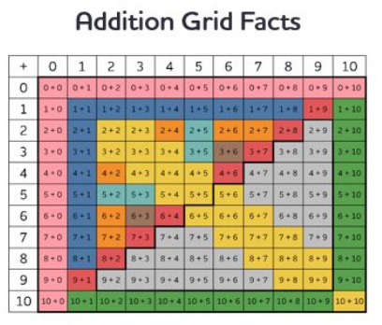

Slide 22
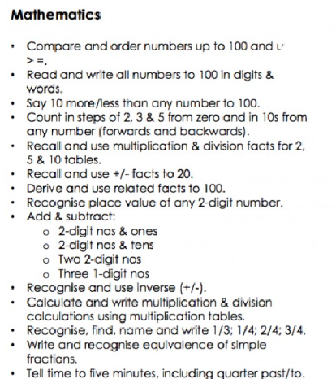
Year 2

Slide 23
Methods and resources
Numicon
Tens frames
Part whole
Number lines
Bead strings
Counters/ cubes

Slide 24
Numicon – your turn
Find the shapes and order them 1 – 10
• Recognising numbers – Show me? Prove it?
• What do you notice about the shapes?
• What happens when you add a 1 (orange) to the 2? The three? Etc. (show me!)
• Show me one more than 6? Prove it?

Slide 25
Bead Strings - your turn
• Make me the number 25? How do you know?
• Make me the number 56? How do you know?
• Count in 1s up to 20
• Count in 2s up to 20
• Count in 5s up to 20

Slide 26
Number Lines – your turn
Draw yourself a number line and mark of, in 1s numbers to 0 – 10.
• You are going to work out 3 + 5 =
• So you would circle the 5 as it’s the largest number and then count on 3.
• This could be in 3 ones or as one jump of 3.
• The solution is the final number we jump on.

Slide 27
Dienes / Base Ten – your turn
Can you make me the number 15? Prove it?
• Can you make me the number 56? Prove it?
• Can you make me the number 129? Prove it?
Use of a visual tool alongside the practical - https://www.coolmath4kids.com/manipulatives/ba se-ten-blocks

Slide 28
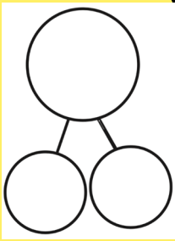
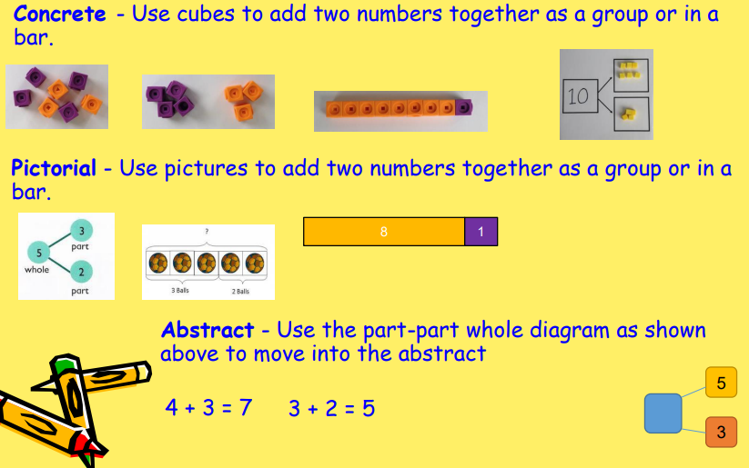
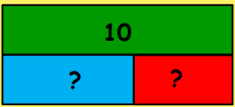
Part- Whole/Bar model

Slide 29
Supporting your child at home
Encourage your child to talk to you about what they are learning / doing in maths
• Ask them to show you how to use the models and images they are using in the classroom
• Ask an adult if you are not sure how a strategy works.
• Don’t move them on to formal written methods – KS1 maths contains lots of important foundations to enable your children to be successful when they move on to them in KS2.

Slide 30
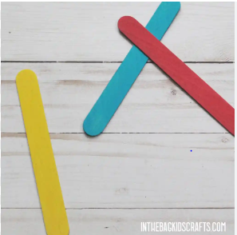
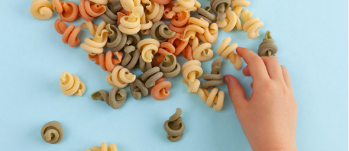


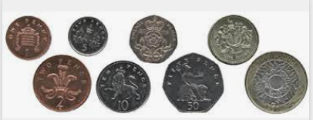

What can you use at home?

Slide 31
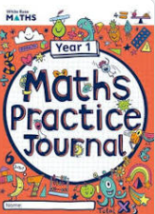
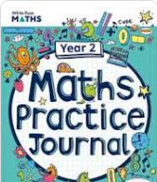
Homework
Your children will have maths homework every week , to help to keep their key skills ticking over. Please encourage them to complete their homework with you and get them to explain their methods.

Slide 32
What are the characteristics of a child who is good at maths?
A child who:
• takes risks
• asks questions and explores alternative solutions without fear of being wrong
• enjoys exploring and applying mathematical concepts to understand and solve problems
• explains their thinking and presenting their solutions to others in a variety of ways
• reasons logically and creatively through discussion of mathematical ideas and concepts
• becomes a fluent, flexible thinker able to see and make connections

Slide 33
Thank you
Any questions

Slide 34
Online resources
https://www.bbc.co.uk/teach/supermovers/ks1-maths-counting-with-john-farnworth/zbct8xs
https://www.youtube.com/watch?v=amxVL9KUmq8
https://www.bbc.co.uk/cbeebies/puzzles/numberblocks-number-magic-quiz-level-2
https://www.topmarks.co.uk/maths-games/5-7-years/counting
https://www.topmarks.co.uk/maths-games/hit-the-button
https://www.topmarks.co.uk/learning-to-count/paint-the-squares

Slide 35
1. Shape activity At home, or when you are out:
Choose a shape for the week, e.g. a square. How many of these shapes can your child spot during the week, at home and when you are out?
2. How heavy?
Ask your child to find something that weighs close to 1 kilogram. Can he / she find something that weighs exactly 1 kilogram? Find some things that weigh about half a kilogram

