Slide 1
Dukes’ Barn
Learn through adventure

Slide 2
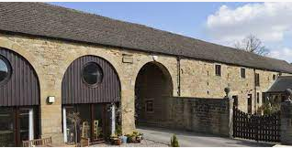
What’s IT like?

Slide 3
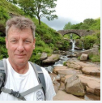
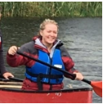
The leaders and Staff

Slide 4
Food
Deeeeeeeeelicious!
Home cooked
Home baking
Enough breakfast to keep you going all day.

Slide 5
Activities
Abseiling
Canoeing
Weasling
Evening walk
Disco

Slide 6
Clothing
Dukes’ Barn provide waterproofs and wellies
Swimwear is required for modesty
Children will need a pair of slippers or indoor shoes. (Crocs, sliders are fine)
Old trainers (which will get wet) for canoeing.
Layers are best- leggings and joggers
No jeans
Disco outfit

Slide 7
No Electronics
No phones
No games consoles
Staff will have IPADS to take photos
Dukes Barn Assembly.

Slide 8
Timings
Will leave school around 9 15
Children will be very busy
Leave Dukes Barn around 1.30pm. Please pick the children up around 2:00pm as they will be very tired.

Slide 9
Sleeping arrangements
Children will sleep in dormitories with an adult next door.
Lots of checks will be done at night, children will know where their designated adult is.
Practise making your bed!

Slide 10
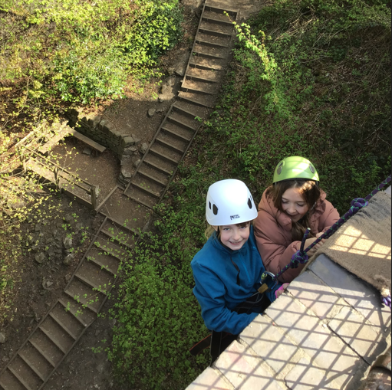
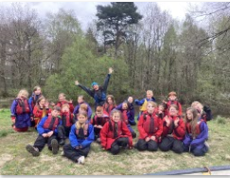
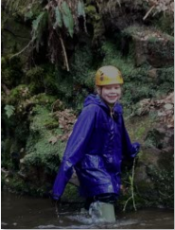
Any Questions…..
Encourage your children to be brave. Dukes’ Barn offers a fantastic experience.
Nobody will be forced to do any activity but they will be asked to support their group.

